Slide 1
Final Presentation
G7T4 – Team Fourtress

Slide 2
Schedule

Slide 3
Actual Vs Planned Schedule
Notes:
Don’t copy and paste from spreadsheet. Show timeline representation

Slide 4
Dropped any functionalities?
NO

Slide 5
Frameworks
MVC

Slide 6
External Libraries
Jgrapht
Json-smart
Opencsv
Commons-lang
Mysql-connector-java
Jcommon
Jfreechart
Is203-jwt
Gson
Nimbus-jose-jwt

Slide 7
Problems faced in scheduling
Forecasting # of hours required for a task
Planning pair programming days and time
Some people work better in the day, others at night

Slide 8
Overcoming these problems
Discussing schedule and timetable before each iteration
Adapting to your partner’s work habits

Slide 9
Improvements from progress update

Slide 10
Comments received in week 10
Programming hours not balance

Slide 11
Improvements on project management
Members with overly high hours did more admin work, architecture design and less programming
Team members revised functionalities together

Slide 12
Breakdown of Work

Slide 13
Programming Tasks
Notes:
Reference slides for design

Slide 14
Notes:
Separate the programming tasks from the non-programming tasks. For programming tasks, show us the task allocation as well as the hours spent by each team member.
Explain why your work allocation was fair. Show us absolute numbers as well as percentages.

Slide 15
Notes:
Separate the programming tasks from the non-programming tasks. For programming tasks, show us the task allocation as well as the hours spent by each team member.
Explain why your work allocation was fair. Show us absolute numbers as well as percentages.

Slide 16
Notes:
Separate the programming tasks from the non-programming tasks. For programming tasks, show us the task allocation as well as the hours spent by each team member.
Explain why your work allocation was fair. Show us absolute numbers as well as percentages.

Slide 17
Notes:
Separate the programming tasks from the non-programming tasks. For programming tasks, show us the task allocation as well as the hours spent by each team member.
Explain why your work allocation was fair. Show us absolute numbers as well as percentages.

Slide 18
Notes:
Separate the programming tasks from the non-programming tasks. For programming tasks, show us the task allocation as well as the hours spent by each team member.
Explain why your work allocation was fair. Show us absolute numbers as well as percentages.

Slide 19
Notes:
Separate the programming tasks from the non-programming tasks. For programming tasks, show us the task allocation as well as the hours spent by each team member.
Explain why your work allocation was fair. Show us absolute numbers as well as percentages.

Slide 20
Notes:
Separate the programming tasks from the non-programming tasks. For programming tasks, show us the task allocation as well as the hours spent by each team member.
Explain why your work allocation was fair. Show us absolute numbers as well as percentages.

Slide 21
Notes:
Separate the programming tasks from the non-programming tasks. For programming tasks, show us the task allocation as well as the hours spent by each team member.
Explain why your work allocation was fair. Show us absolute numbers as well as percentages.

Slide 22
Notes:
Separate the programming tasks from the non-programming tasks. For programming tasks, show us the task allocation as well as the hours spent by each team member.
Explain why your work allocation was fair. Show us absolute numbers as well as percentages.

Slide 23
Non-Programming Tasks
i.e. meetings, planning for milestones, etc.
Notes:
Reference slides for design

Slide 26
Overall Hours
Notes:
Reference slides for design

Slide 28
Task and Bug Metrics

Slide 31
Challenges Faced

Slide 32
Problems discovered from TM

Slide 33
Resolution of problems
Notes:
Task Metric

Slide 35
Challenges Faced
Debugging had to be done before anything else after UAT
The need to debug after bug metrics hit a score of 10 delayed features
Debugging took longer than expected
💣

Slide 36
Problems discovered from BM
Login
Bootstrap
Breakdown
Top-k Popular
Additional File Upload
Top-k companions
JSON

Slide 37
Resolution of problems
Group met up to debug together
We spent hours debugging, often into the early hours of the morning
No additional functionalities programming until bugs were resolved when score >=10

Slide 38
GIT

Slide 40
Test Scores

Slide 41
What if we reran our UAT now?

Slide 42
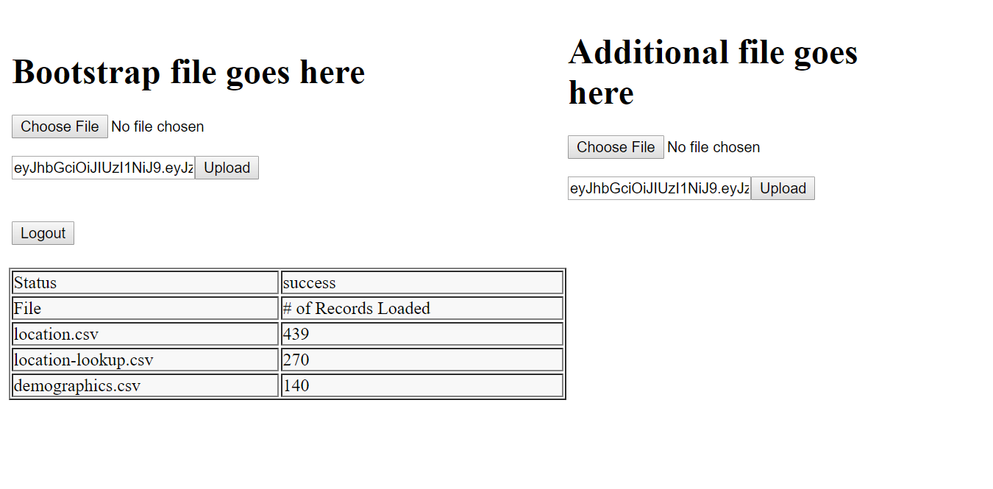
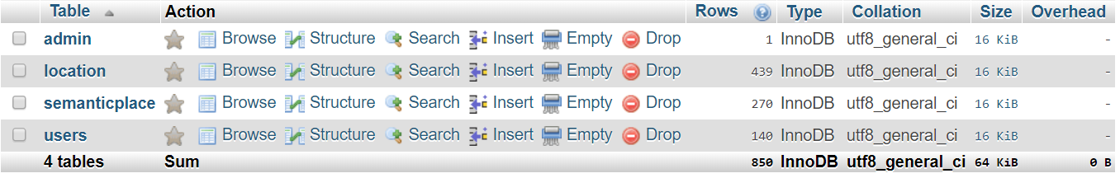
Basic Bootstrap
Score: 1 / 1

Slide 43
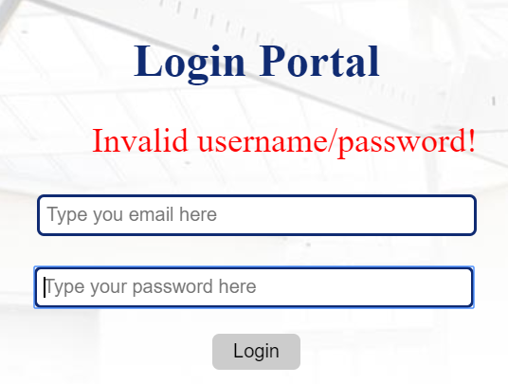
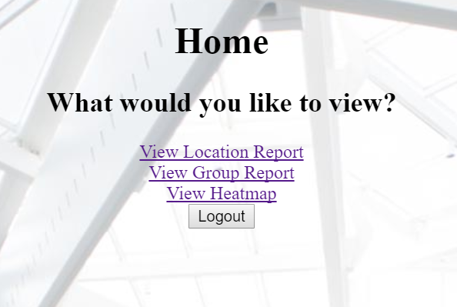
Login
Score: 3 / 3

Slide 44
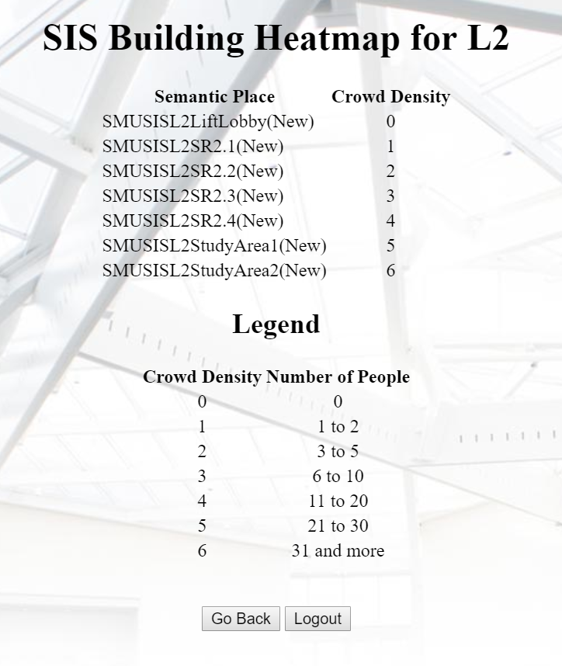
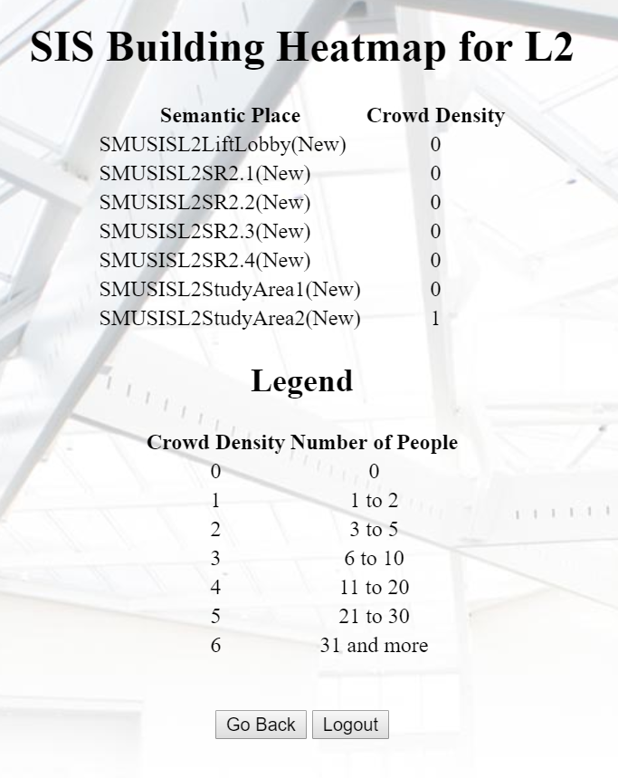
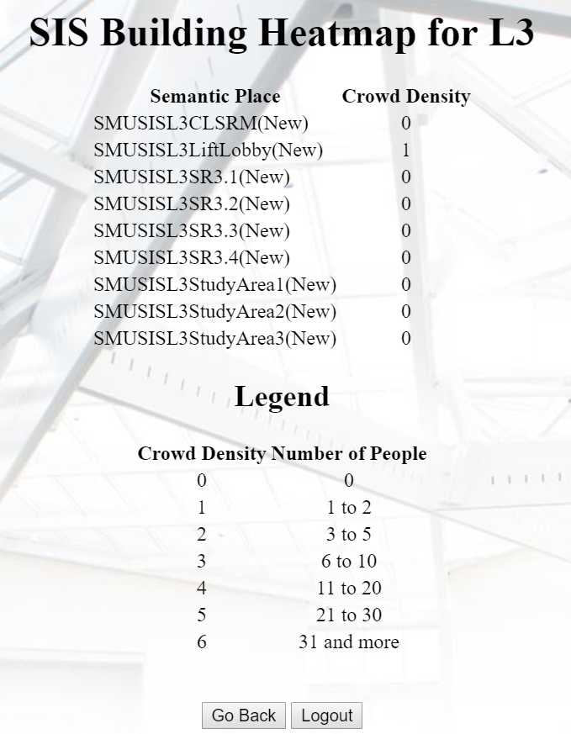
Heatmap
Score: 3 / 3

Slide 45
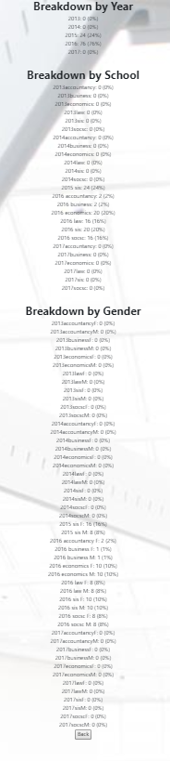
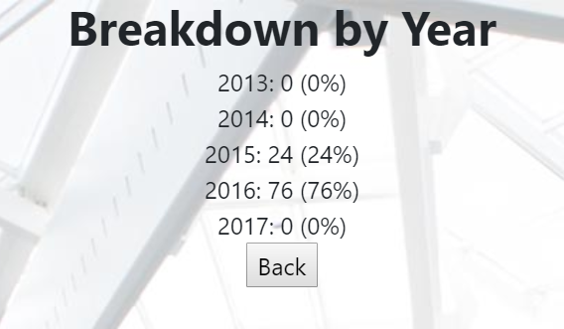
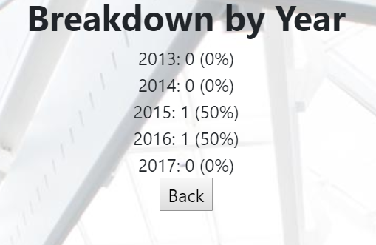
Breakdown by year/gender
Score: 3 / 3

Slide 46
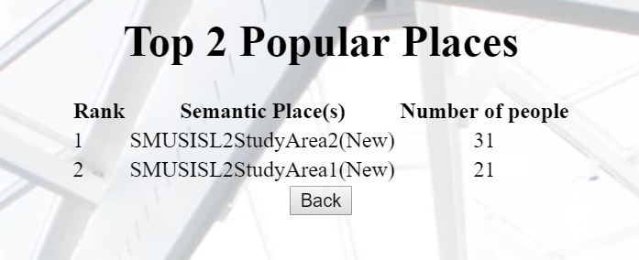
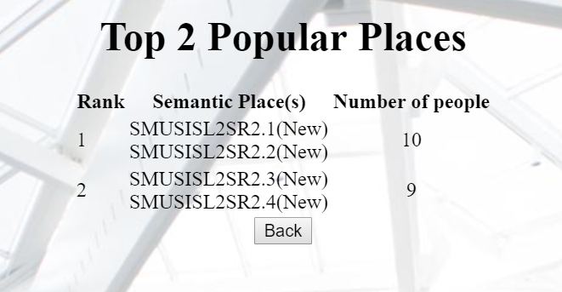
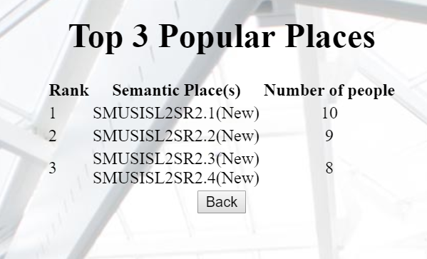
Top-k popular place
Score: 3 / 3

Slide 47
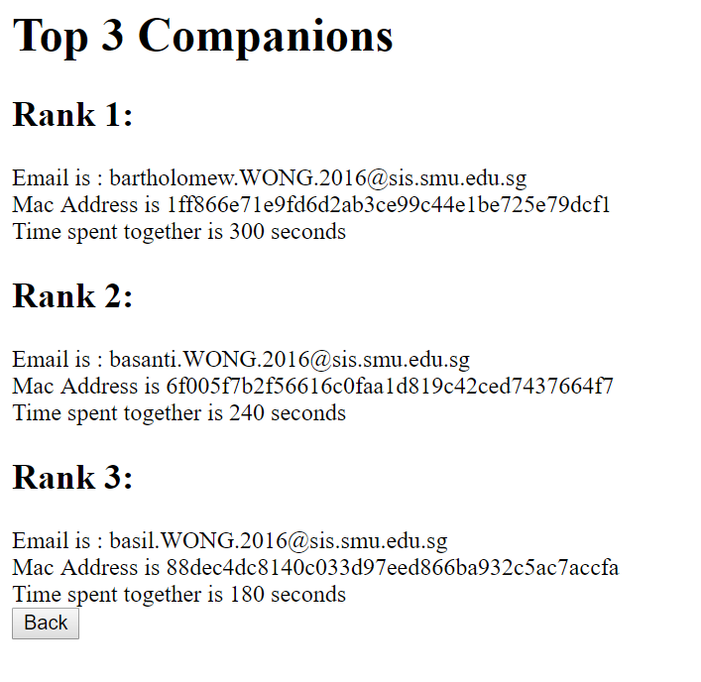
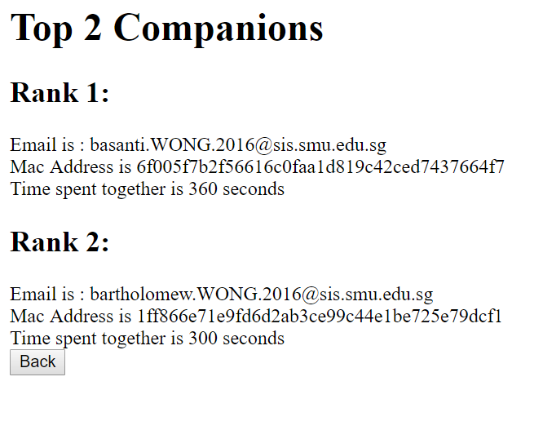
Top-k companion
Score: 2 / 2

Slide 48
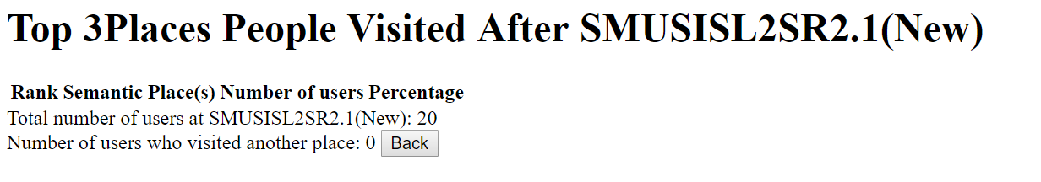
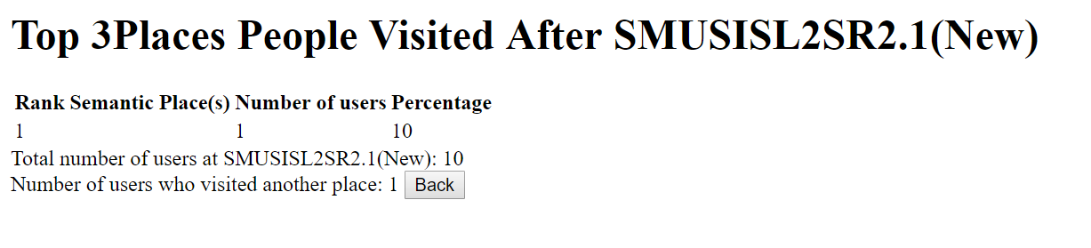
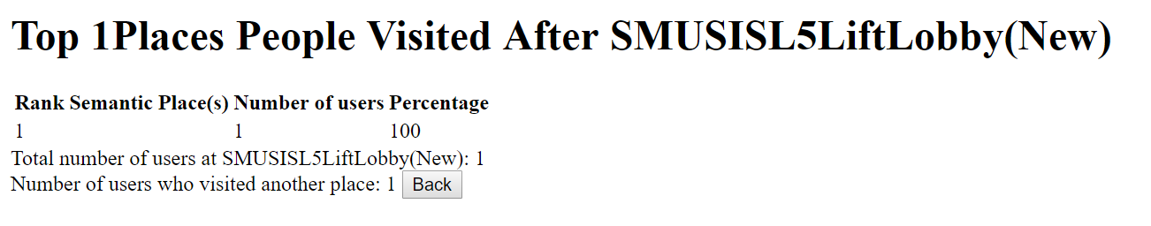
Top-k next place
Score: 1 / 3

Slide 49
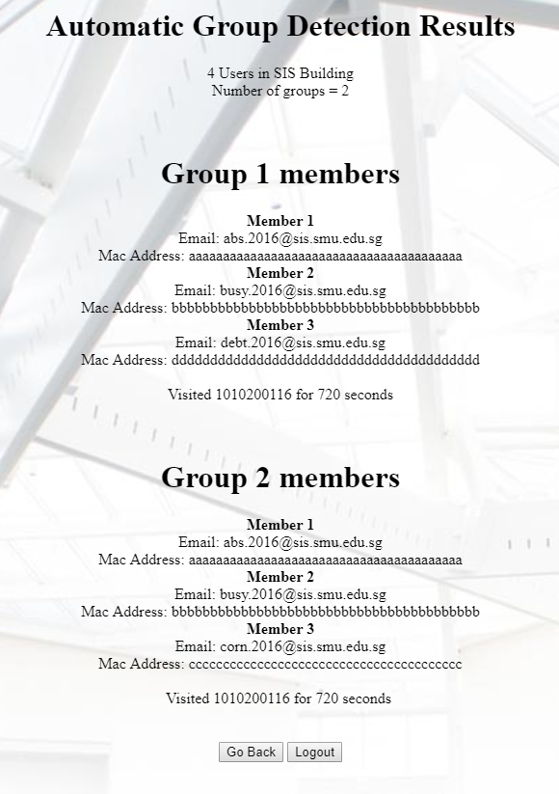
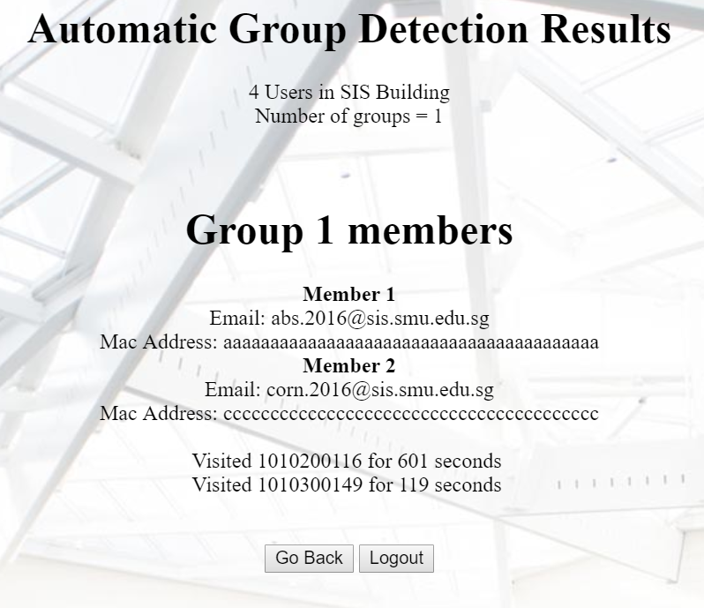
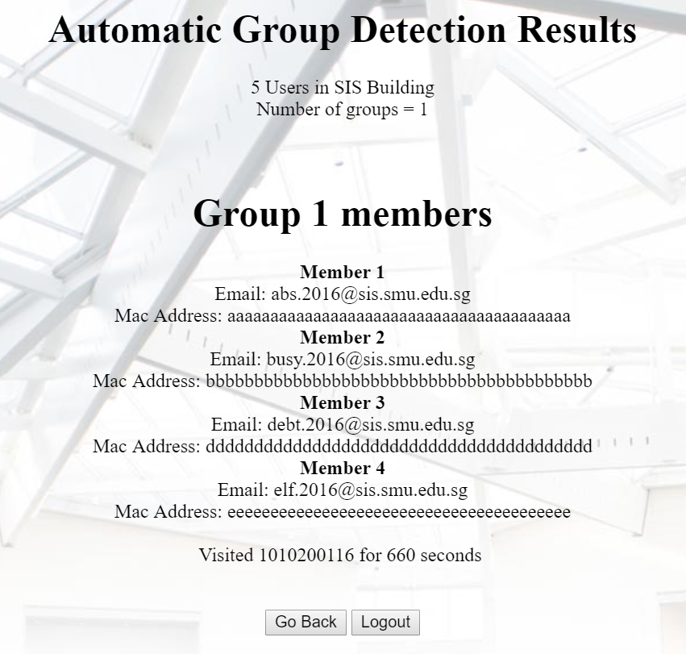
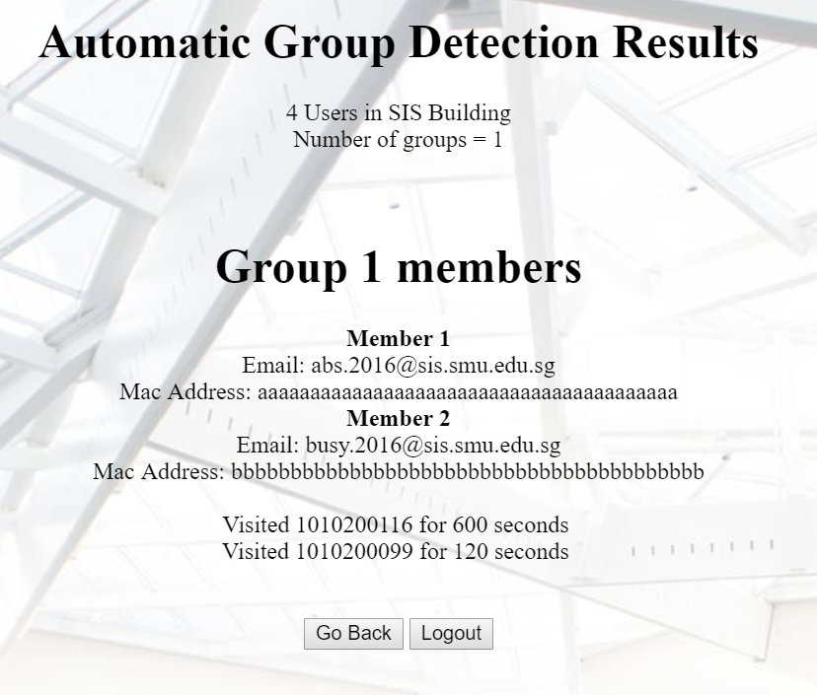
Group detection
Score: 3 / 4

Slide 50
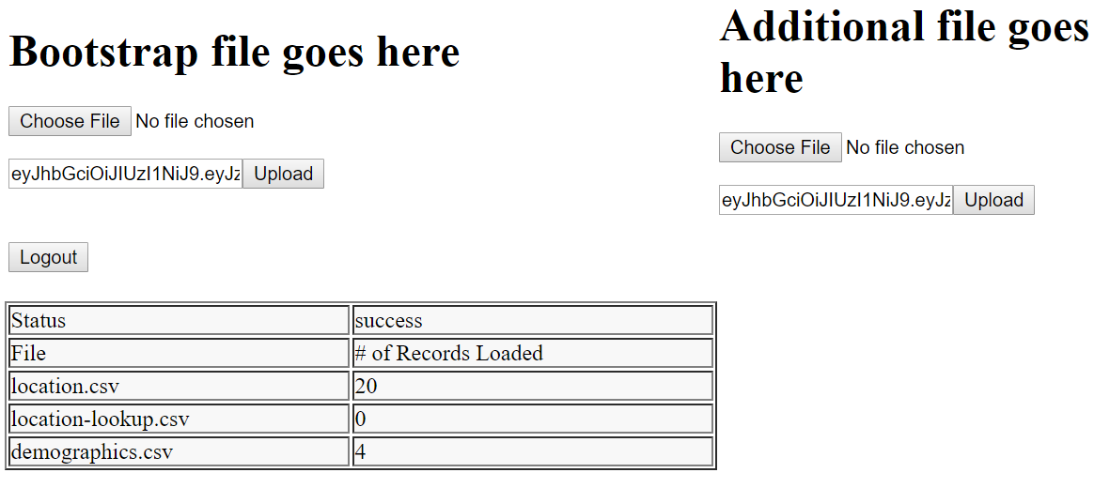
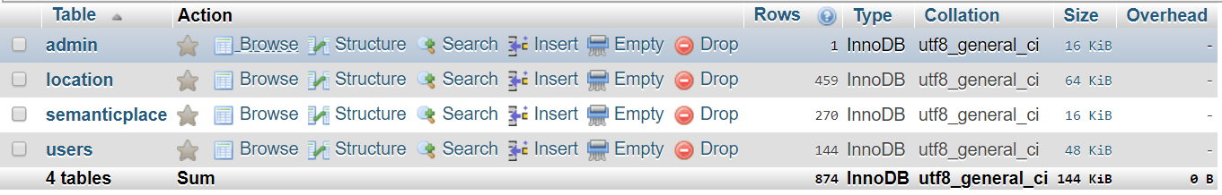
Upload additional files
Score: 1 / 1

Slide 51
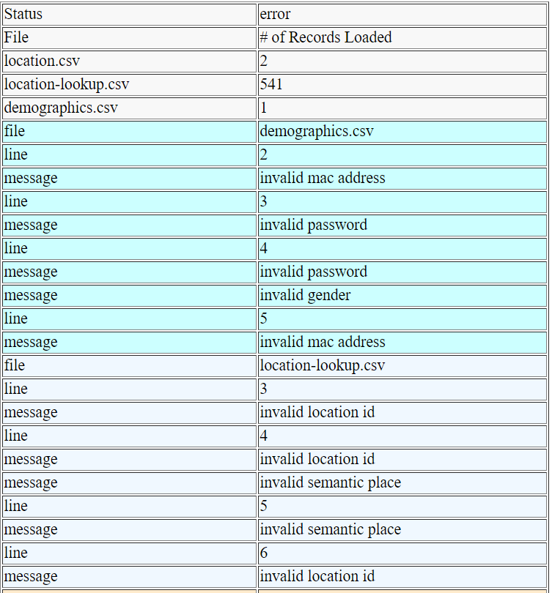
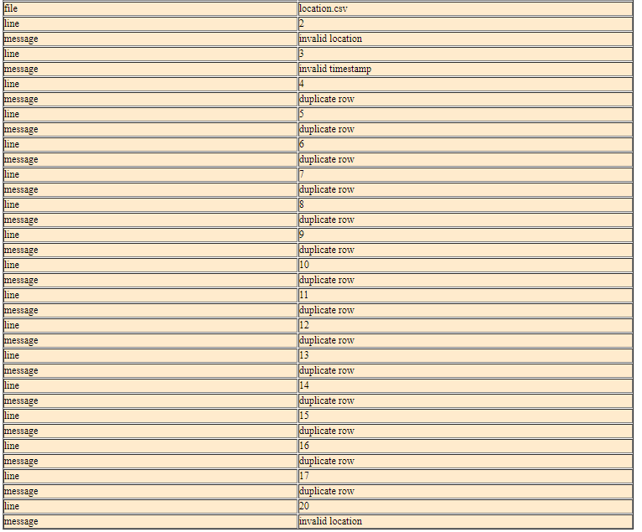
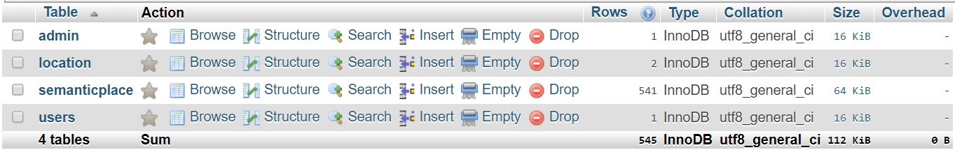
Bootstrap validation
Score: 1 / 1

Slide 52
Score: 21 / 24

Slide 53
Server information

Slide 54
Our app can be found at 18.221.186.189
Notes:
Reference slides for design

Slide 55
Administrator
Username: admin
Password: password

Slide 56
Others AKA everything else

Slide 57
Main takeaways
Notes:
Reference slides for design

Slide 58
Main Takeaways
Teamwork matters
OOAD grades do not matter in SE
Planning before coding is essential
Coding without a sequence diagram results in messy codes
Be respectful to one another even in periods of conflict

Slide 59
Issues
Resolution
Pair programmer coming in late
Programming outside of PP hours
Buys a drink for his/her partner
Consultation with Prof

Slide 60
Interesting facts about members
Jane is very uncomfortable about working beyond midnight
Jorden likes to make his partners PP overnight
Eugene has walked/cycled to Jorden’s house xxx times for work
Feng Feng likes to praise people in Mandarin
Wei Ling often offers to buy food for everyone
👦👧👦👧
👧

Slide 61
SE was really hard.
We’re glad that we survived.
Notes:
Reference slides for design

Slide 62
END
Notes:
Every slide below this is for design references

